Slide 1



Stock projection of Palantir

Slide 2


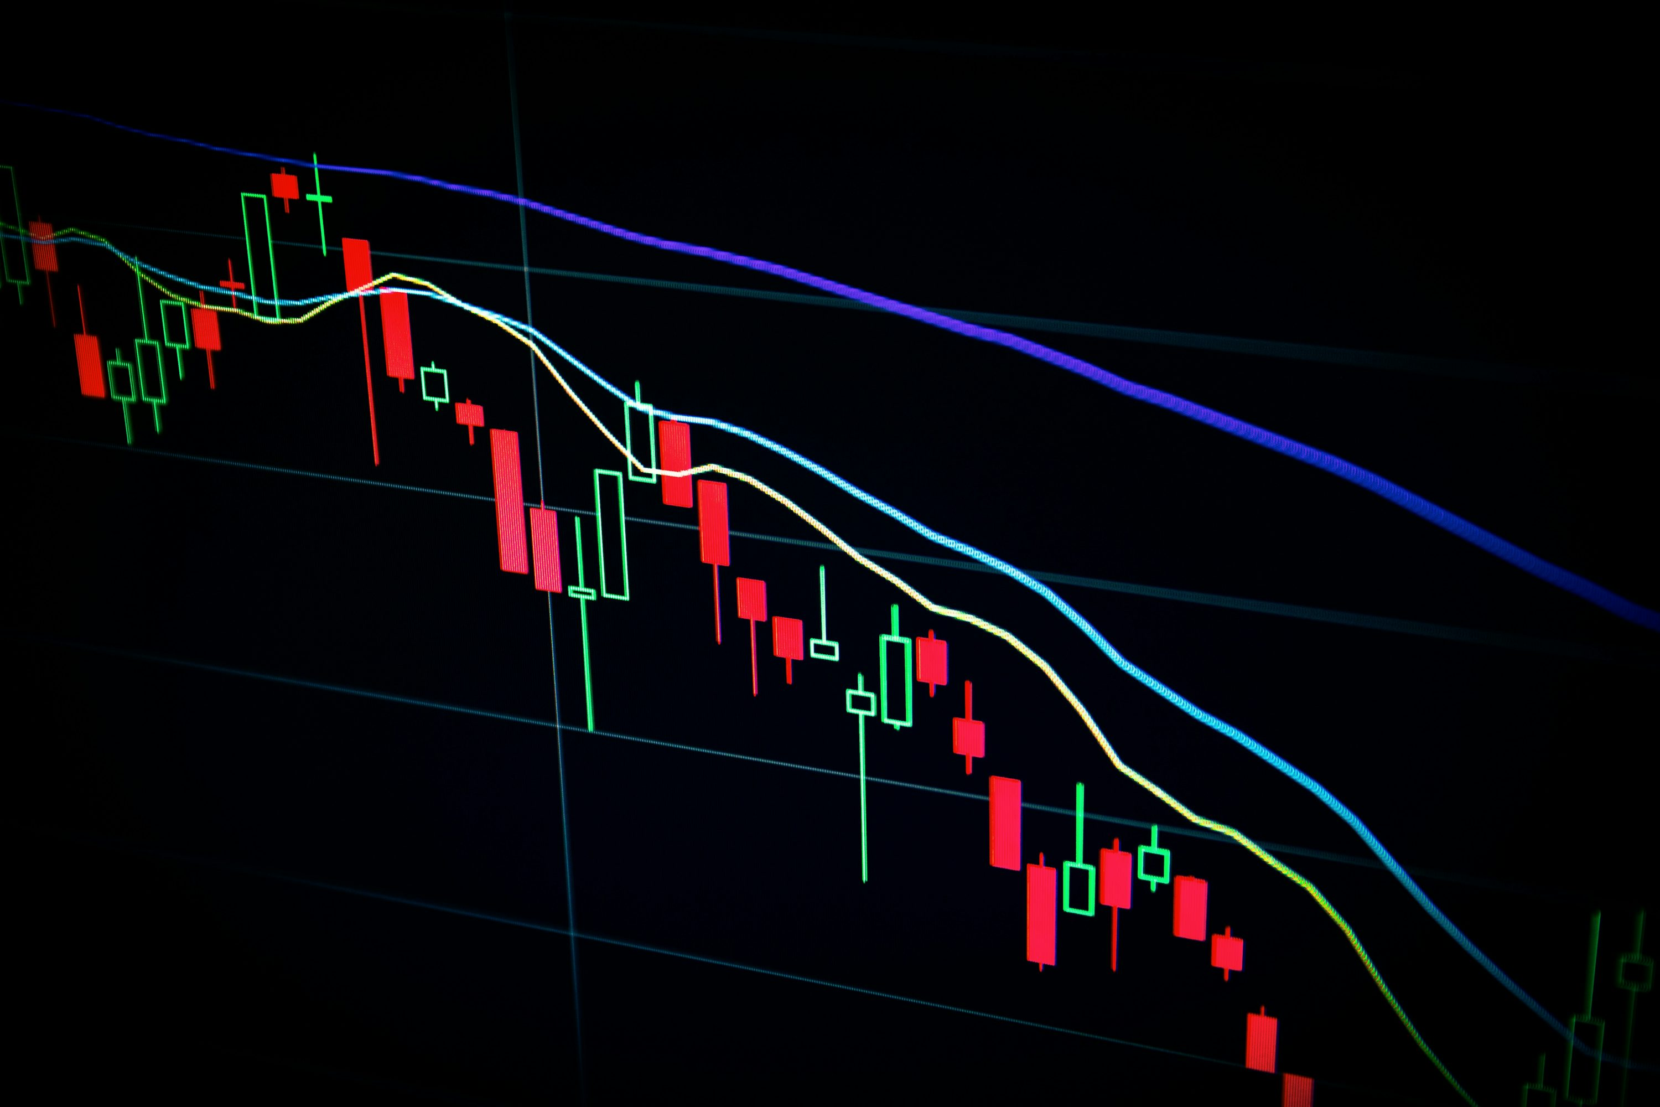



Why this project?
Trading is extremely challenging and often unpredictable, (especially on a day-to-day basis).
Anything that helps predict whether the price will move up or down the next day is a significant advantage and can be the difference between making and losing money.
I have a strong personal interest in the stock market and I’m always curious about how to make better decisions.
Palantir is an exciting company, and their business model is essentially real-life deep learning → so it felt like a perfect fit for this project.
Ideal Opportunity to combine content from UW’s business school and the college of engineering.

Slide 3






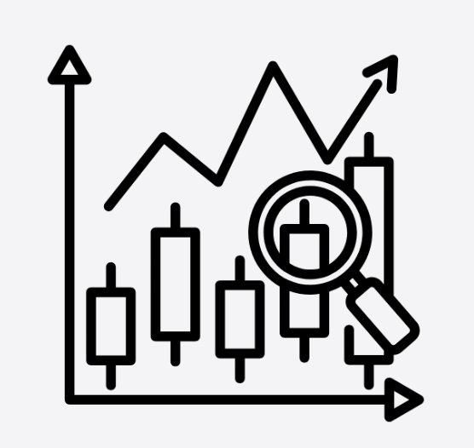
The basis: What data was used?
1) Closing Price
2) Volume traded
3) Moving Average
4) Technical Indicators
RSI-14: Measures if the stock is overbought or oversold
MACD: Shows trend strength by comparing fast vs slow moving averages
MACD Signal: Smoothed MACD used to trigger buy/sell signals
MACD Histogram: Difference between MACD and Signal; shows momentum.
Bollinger Band Width: Measures volatility (wide = high volatility).
ROC-10: Percent change from 10 days ago (momentum)
ATR-14: Average size of daily price moves (volatility)
Stochastic-K: Shows where today’s price sits between recent high/low (momentum)

Slide 4
Model walkthrough
Data loading and cleaning
Creating and
selecting features
Scale and Split
Sequencing
LSTM Architecture
Training
Evaluate and Predict
1
Creation of futures:
  Palantir historical data: Closing price, Volume, 5/10/20-day Moving Averages
  NASDAQ historical data: Closing Price, Volume, 1 day and 5 day returns
  Technical indicators: RSI-14, MACD, MACD Signal, MACD Histogram, Bollinger Band Width, ROC-10, ATR-14, Stochastic-K
Split = All rows but the last 100 (test set) are used for the training
Introduction of 2-layer LSTM model that is fed with 60 days and the defined features. Model learns trends. At every time stamp the model creates a hidden state. The final one is used as representation for the recent market dynamics. Same hidden state is then delivered to 2 states:
  Regression state: Output is the next day closing price
  Classification State: Using Sigmoid. Output 0 or 1. This is the probability for going up or down.
Used Adam optimizer and mini-batches for stable convergence
1
2
2
3
3
4
4

Slide 5

Results: good but not perfect
Direction
check
✓
✓
✓
✓
✗
✗
✓
✓
✓
Reasons:
Palantir is an incredible volatile stock
Data input not sufficient (more parameters needed)
Market noise (news/events) are not included
Potential Weak points in the model itself

Slide 6



What could be done better?
Richer Data
Advanced Model
Company-specific signals (e.g.: earnings dates, news sentiment, insider trades)
More data that reflects the market noise (Interest rates or relatable ETF’s
Switch to transformer and or improve the current model (hyperparameters, training time, or deeper architecture
Give the LSTM more meaningful information about what drives price changes
&
Improve how well the model learns relationships and avoids overfitting

Slide 7
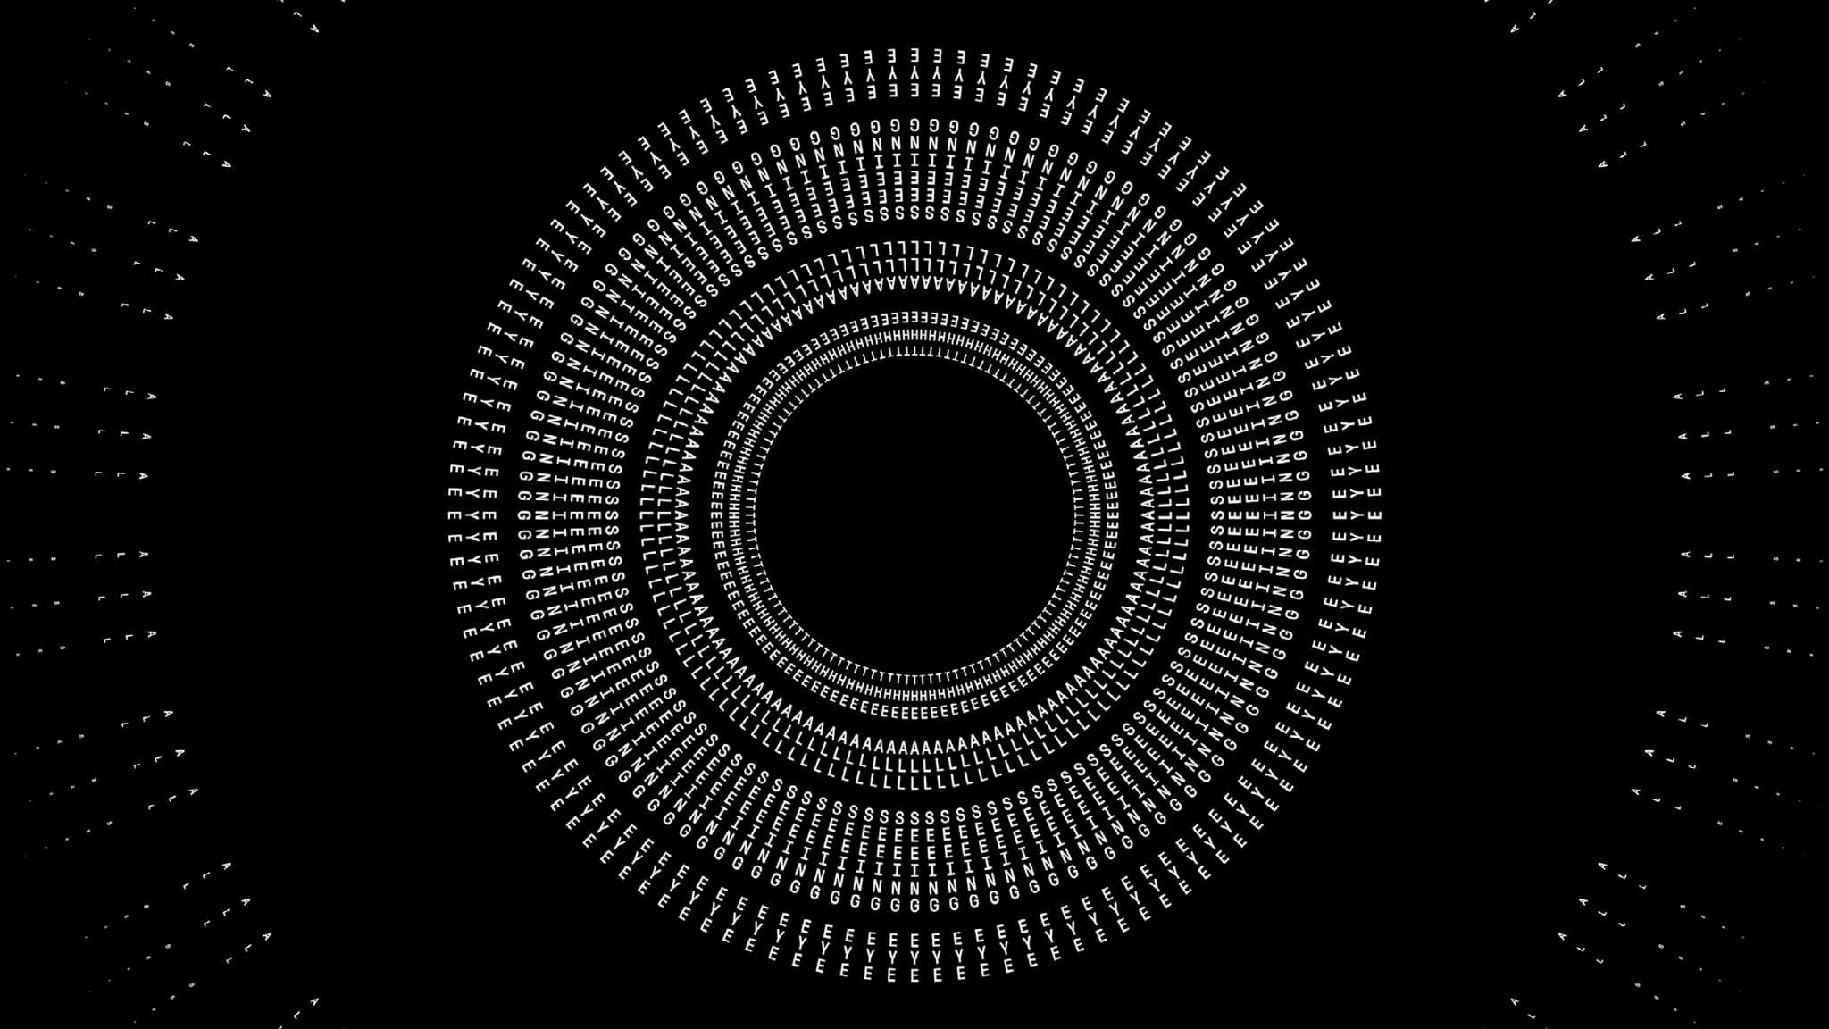
THANK
YOU!

